Slide 1

The Michigan Child Collaborative Care Program (MC3)
Child and Adolescent Health Centers
January 26, 2018

Slide 2
A Public Health Problem
Up to 20% of children have a mental health disorder—the vast majority are undiagnosed.
More than half of children with mental health issues come from homes living at or below the poverty level–the vast majority do not get care.

Slide 3
Consequences of Not Treating Mental Illness in Children
Unidentified and under treated mental illness associated with:
  Chronic illness in adults
  High utilization of services
    Medical and psychiatric
    More frequent hospitalization
  Early childbearing
  Unstable employment
  Substance use
  Violence/suicide/homicide

Slide 4
Michigan Demographics
Michigan children living in poverty
Michigan youth with 2 or more ACEs
1 in 4
28.5%

Slide 5
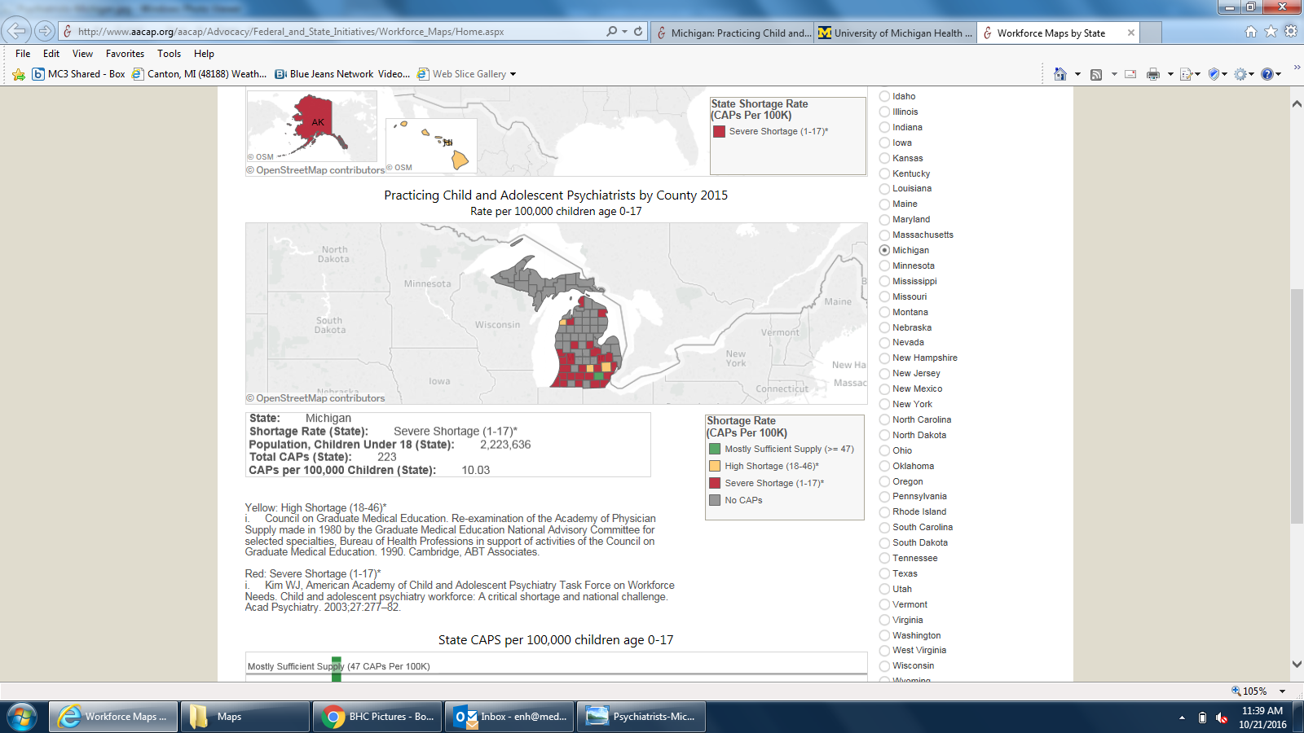
Michigan: Practicing Child and Adolescent Psychiatrists

Slide 6
Why Primary Care Providers?
  78% of psychotropic meds were written by general practitioners, physicians, and other non-physicians (physician assistants, etc.)
  60-70% of PCPs report appointment delays for mental health referrals of 3-4 months

Slide 7
Components of MC3
Telephone Access: Same day consultation for pediatric and perinatal providers
Group Case Consultation
Behavioral Health Consultant Services
Education: webinars, ongoing case consultations and panel reviews
Implementation of screening and follow-up
Outcomes: clinical, adherence, service utilization

Slide 8
MC3 Program Goals
Improve access to psychiatry for youth and perinatal patients
Improve quality of care
  Improve skills of prescribers with regard to MH issues in (diagnosis, treatment, triage to appropriate level of care)
  Improve use of evidence-based medication
Decrease utilization of higher levels of care

Slide 9
How Does it Work?
Prescriber/delegate contacts MC3 BHC
BHC triages call and provides resources, if necessary
CAP and PCP connect
Consult summary sent to PCP

Slide 10

Who Does MC3 Serve?
Infants and children ages infancy through 26
High risk women during pregnancy and postpartum

Slide 11

Michigan Child Collaborative Care Program (MC3)
Covered Michigan Counties
Current MC3 counties
Future Expansion
MC3 not yet available

Slide 12
MC3 Progress To Date
38 providers enrolled
15 counties
29 school-based clinics

Slide 13
Utilization of MC3 Services
66% of enrolled providers from 22 School Based Health Centers* have consulted with MC3
64% of providers who have used MC3 have been repeat users
*76% of clinics with enrolled providers

Slide 14
Service Requests
There were 171 requests for MC3 services, with the following breakdown by type of service requested:
  113 (66%) CAPP to PCP phone consults
  49 (29%) group case consultations
  6 (4%) BHC to PCP consults
  3 (2%) BHC to patient consults

Slide 15
CAPP to PCP Phone Consults
Reasons for request (often multiple reasons)
  130 (86%) medication problem or question
  54 (36%) diagnostic clarification
  10 (7%) seeking information on services
  13 (9%) other

Slide 16
Patient Age

Slide 17
Patient History and Services Utilization
Only 1% of patients reported current psychiatric care at the time of the request for MC3 phone consult
12% of patient consults had a history of hospitalization
61% of patient reported having a family history of mental illness
Recommending higher level of care (CMH) in 5% of cases
Hospitalization/emergency room likely averted in approximately 4% of cases

Slide 18
Funders
State of Michigan
Blue Cross Blue Shield Foundation
Primary Care Association

Slide 19
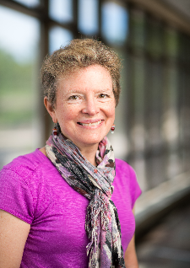
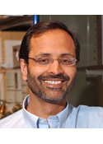
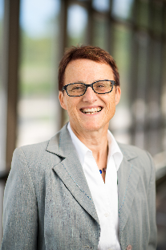
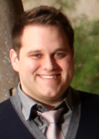
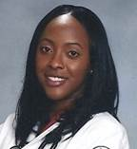
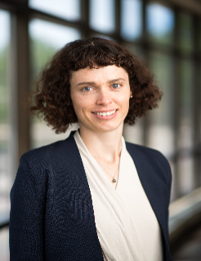
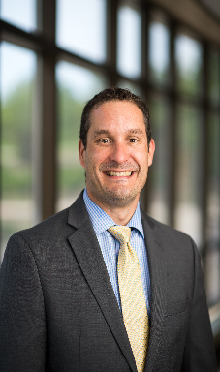

The Consulting Psychiatrists
Dr. Sheila Marcus Dr. Paresh Patel Dr. Maria Muzik Dr. Nasuh Malas
Dr. Dayna Leplatte-Ogini Dr. Joanna Quigley Dr. Rich Dopp Dr. Carrie Gillett

Slide 20
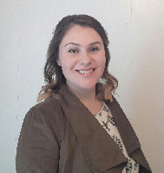
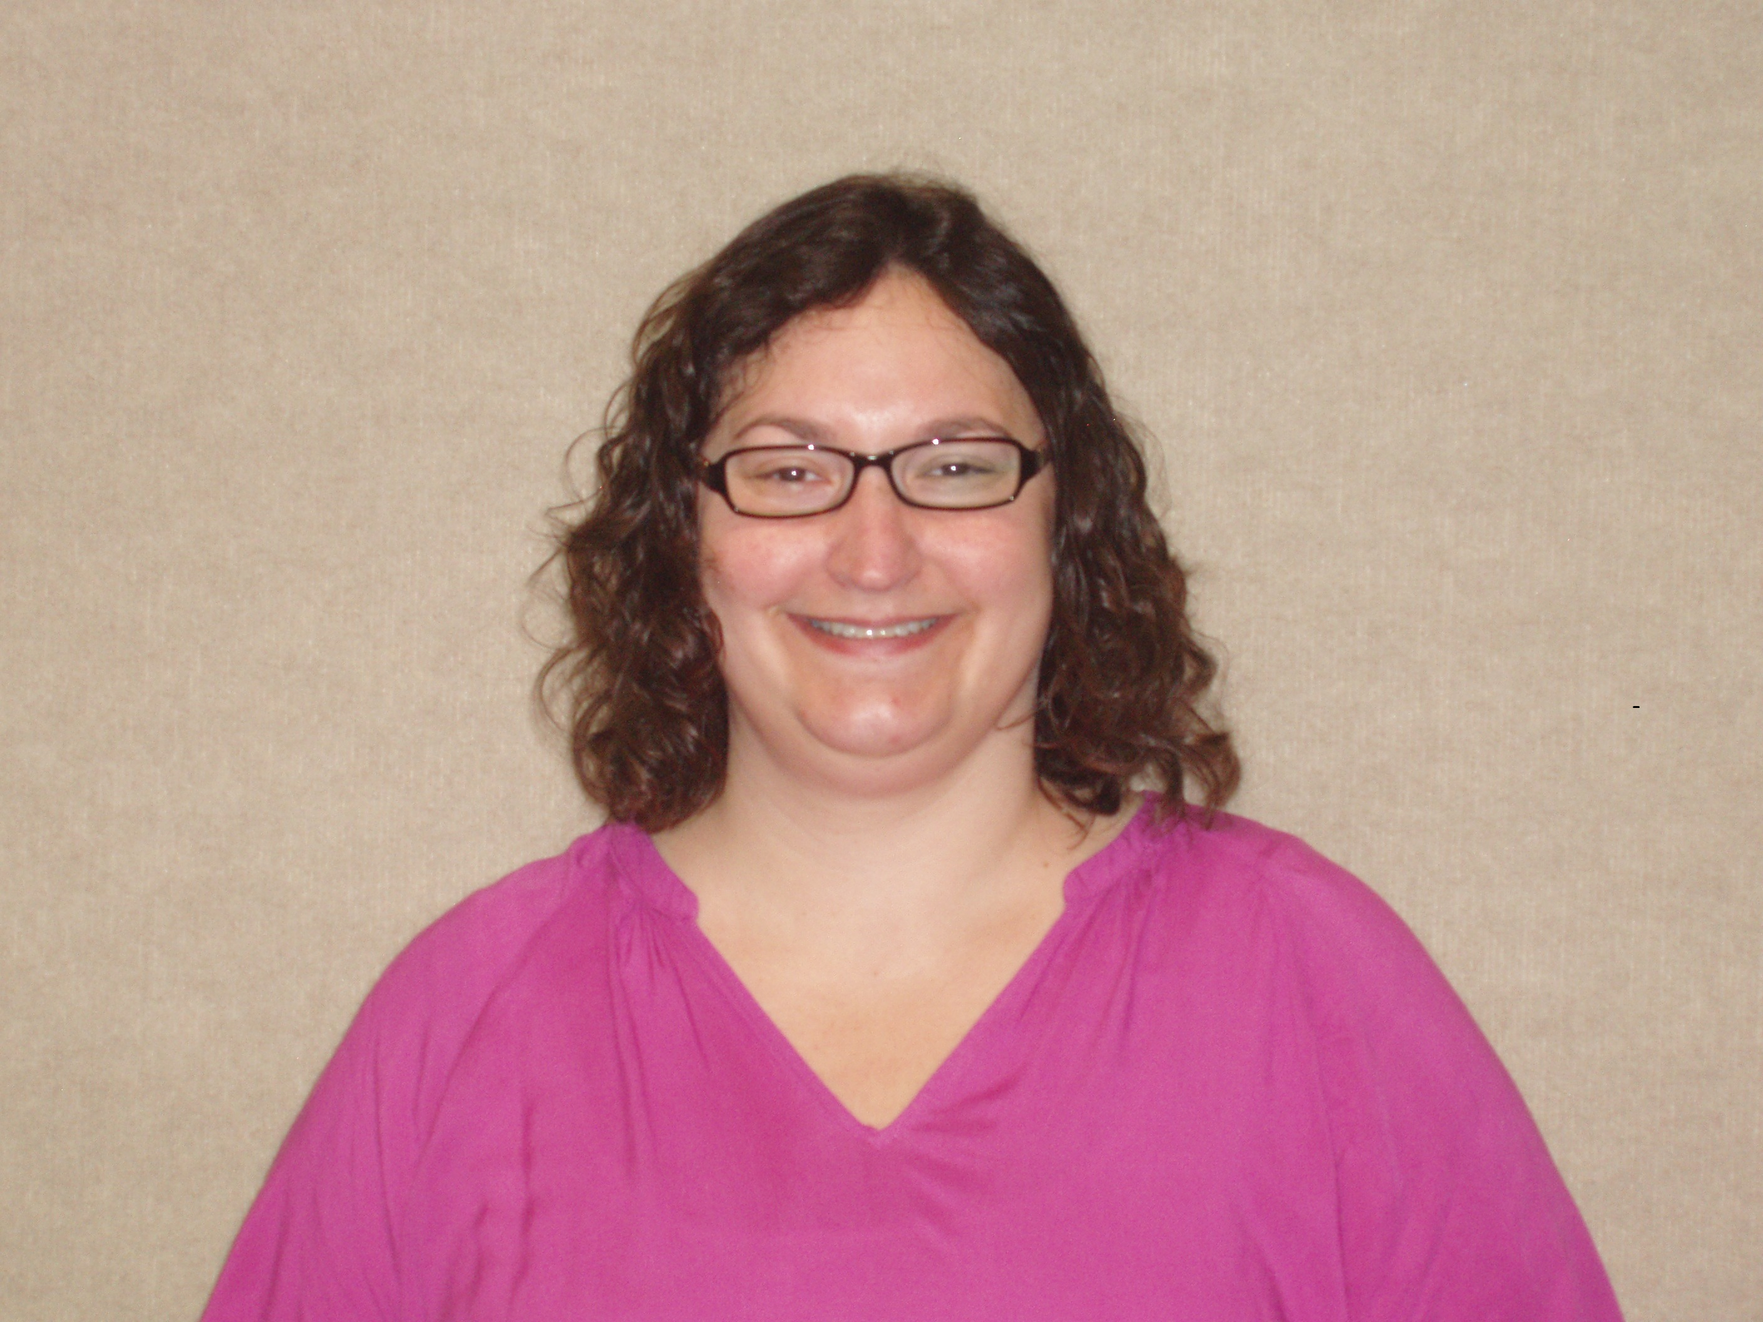
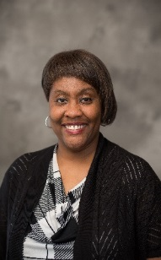

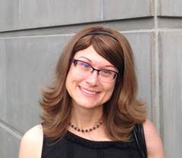

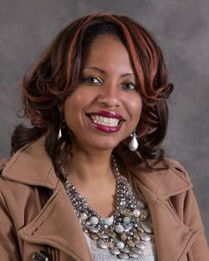
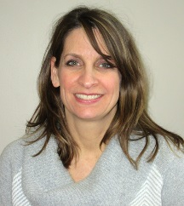
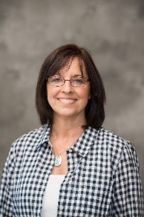
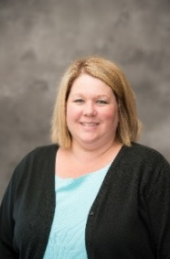

Our Behavioral Health Consultants

Slide 21
Questions?
Contact Us:
Sheila Marcus, M.D.
Medical Director
smmarcus@umich.edu
Anne Kramer, LMSW
Program Manager
ack@umich.edu

